Slide 1

14 May 2022
“Online Student Registration System"
Submitted to -
Ms. Divya Singhal

Slide 2

Online Student Registration System
Group Members :- AMBRISH SHUKLA (Group Leader)
ABHINANDAN SAINI
AADITYA SINGH

Slide 3
INTRODUCTION
Online Student Registration System is a Website designed, and developed for collage students which is for the help of students.
This project designed to better manage the record of Student’s registration and admissions.
With the help of this project it becomes easy for the students to register them selves in the college.
And, the work of registration can be done remotely.

Slide 4
GOAL OF THE PROJECT
Computerize The Manually Operated System

Slide 5
OLD SYSTEM
DISADVANTAGES
Physical presence must (COVID 19)
Less Interactive
Time Consuming

Slide 6
PRESENT SYSTEM
ADVANTAGES
Highly Interactive
Instant Response
Time Saving

Slide 7

SECURITY
If we talk about the security of the data of the students it is safe.
Because if a student wants to register himself on the website
he/she needs a User ID and password to login.
Only after this he/she get able to register him/herself

Slide 8
REQUIREMENTS
Software Requirements:-
Programming Language
HTML(Hyper Text Markup Language).
CSS(Cascading Styling Sheet).
JavaScript.
Database
MongoDB
Operating System
Windows xp,7,10

Slide 9

REQUIREMENTS
Functional Requirements:-
It deals with the functionalities required from the system which are as follows:
The website will help the colleges/organizations/companies to conduct their student registration.
Only authorized person can access related details.
Organizations can change their information regarding themselves. The students can login through TEST-ID and PASSWORD.
Administrator will be responsible for updating the site

Slide 10
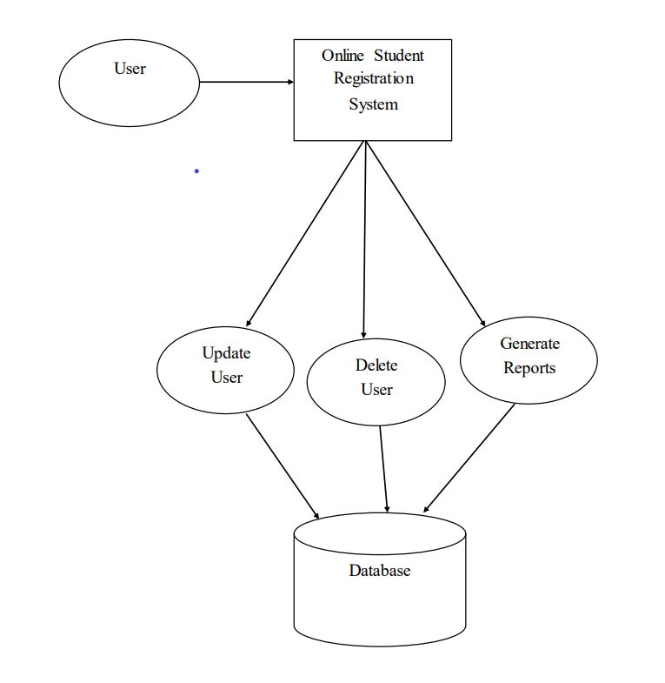
STUDENT CAN DO ?
Level ‘0’

Slide 11
DATA FLOW DIAGRAM (DFD)
Start
Login
Login Failure
No
Is
Login
Successful?
Yes
Level ‘1’
User
Check login type
Administrator
User’s Screen
Administrator’s Screen
Search Module
View Documents
Create User
Upload Documents
Stop

Slide 12

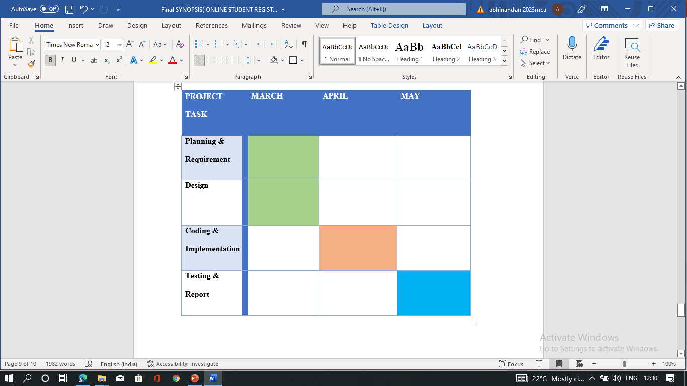
GANTT CHART

Slide 13
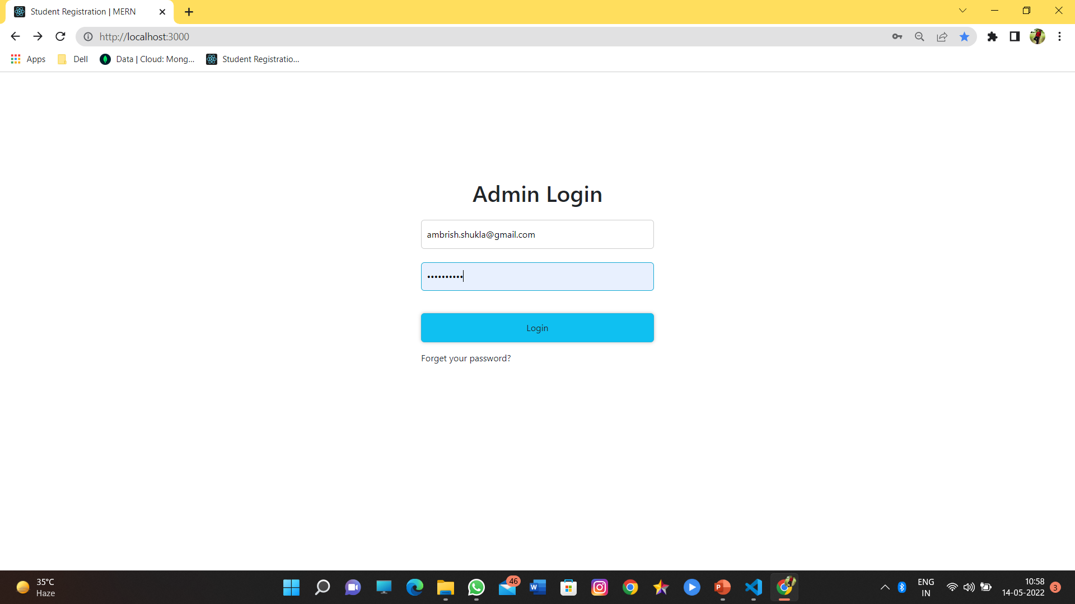

Slide 14
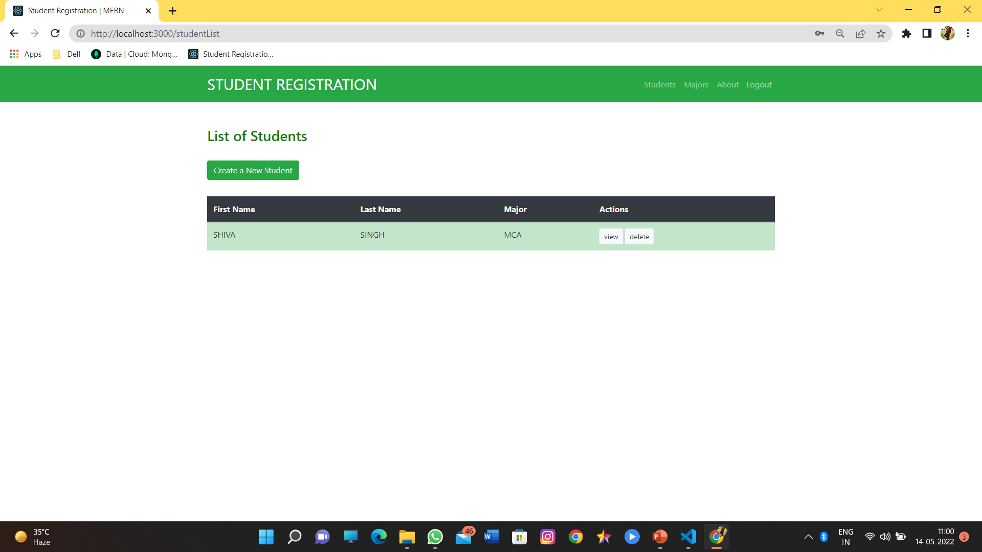

Slide 15
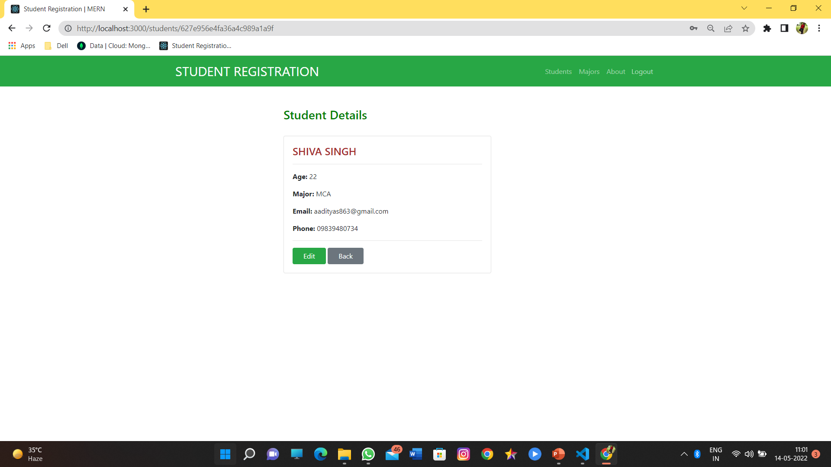

Slide 16
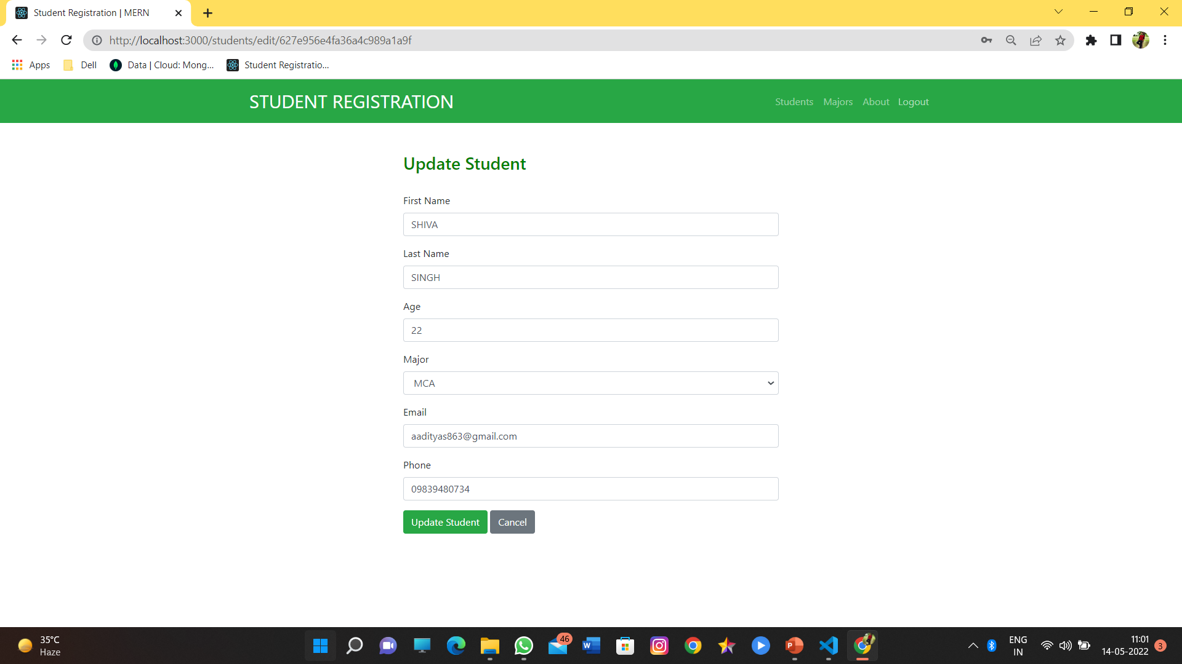

Slide 17
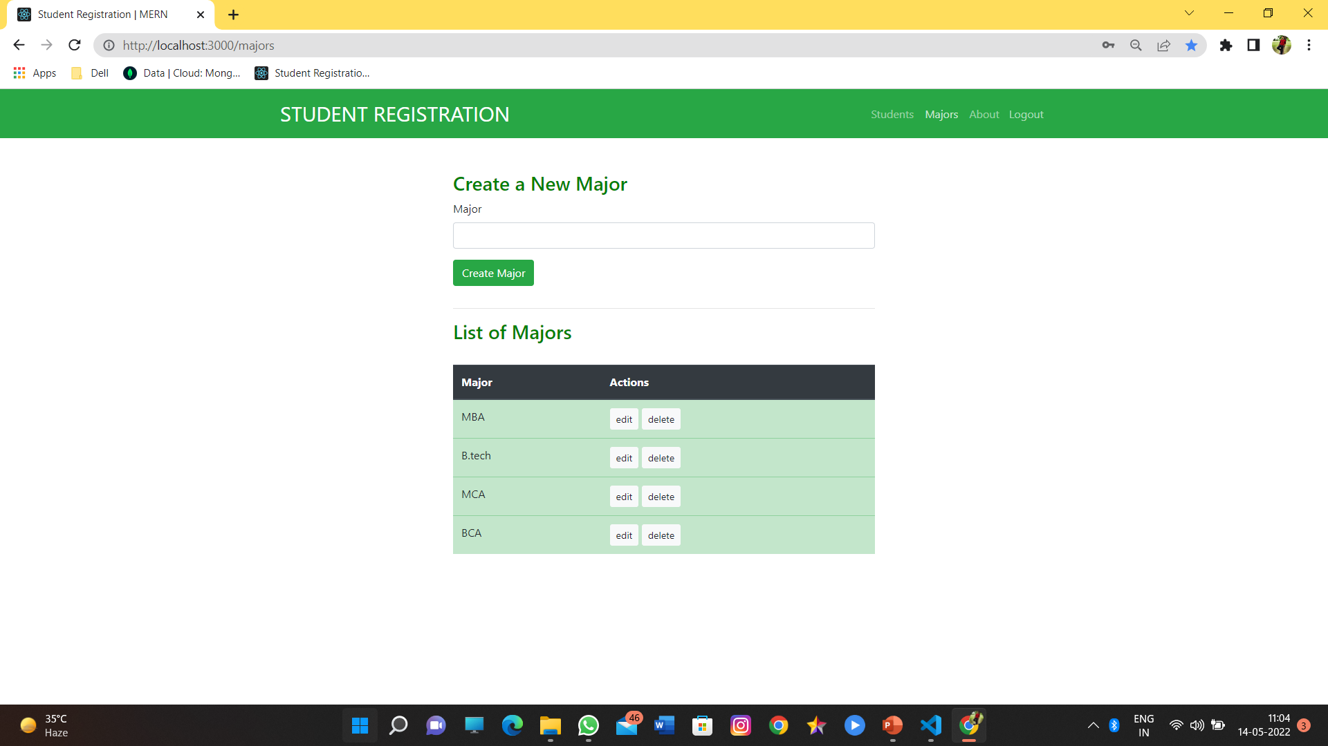

Slide 18
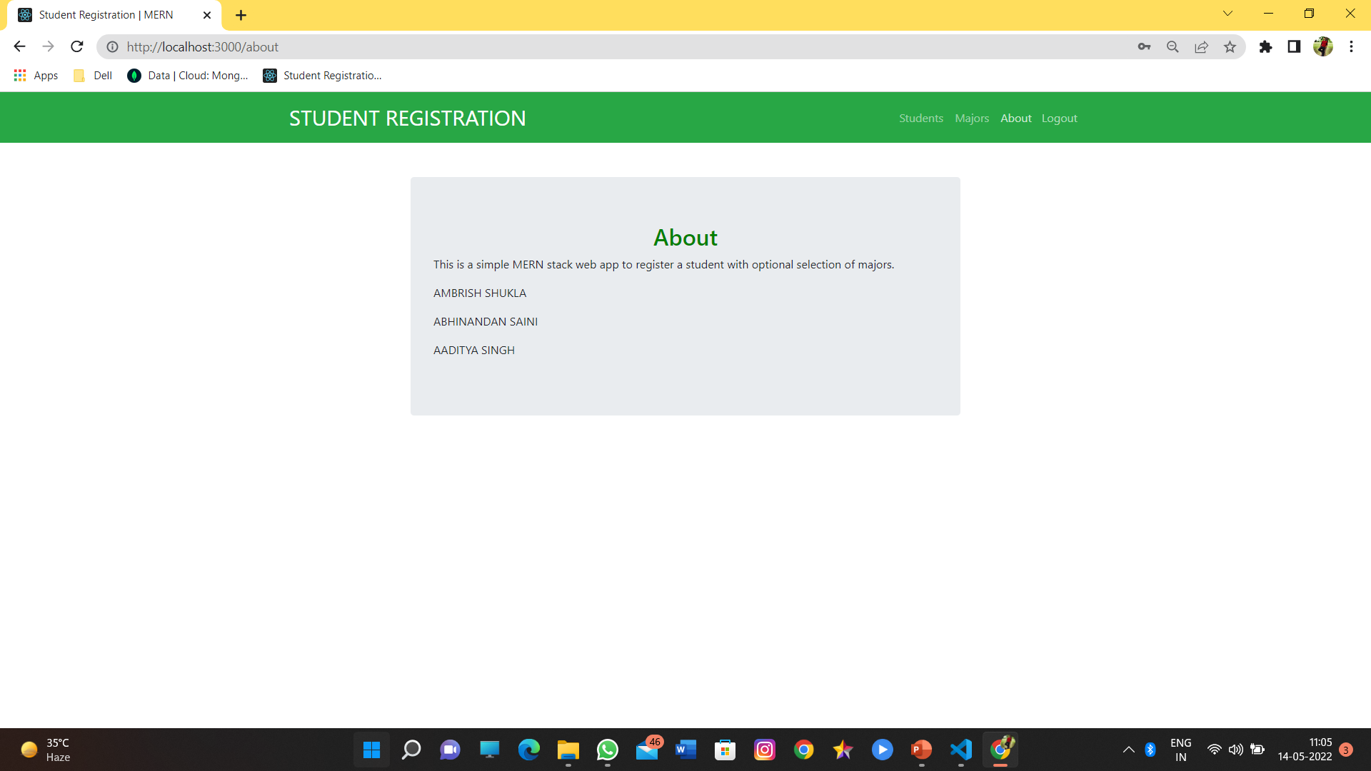

Slide 19

thankyou

